Slide 1
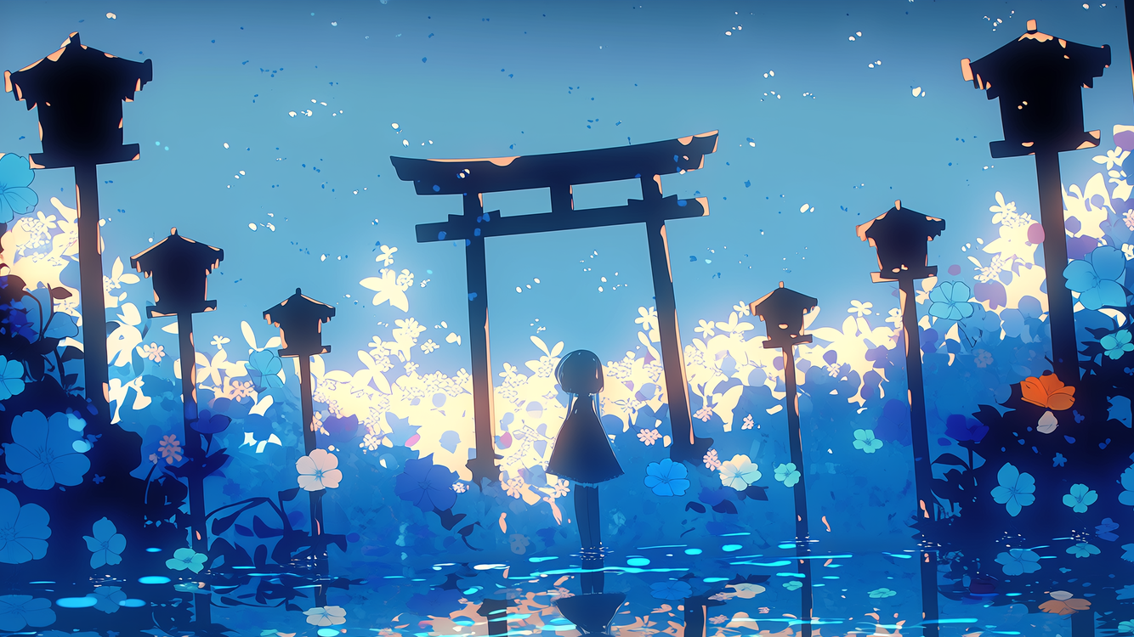
Healing Music
-神域の迷い子-

Slide 2
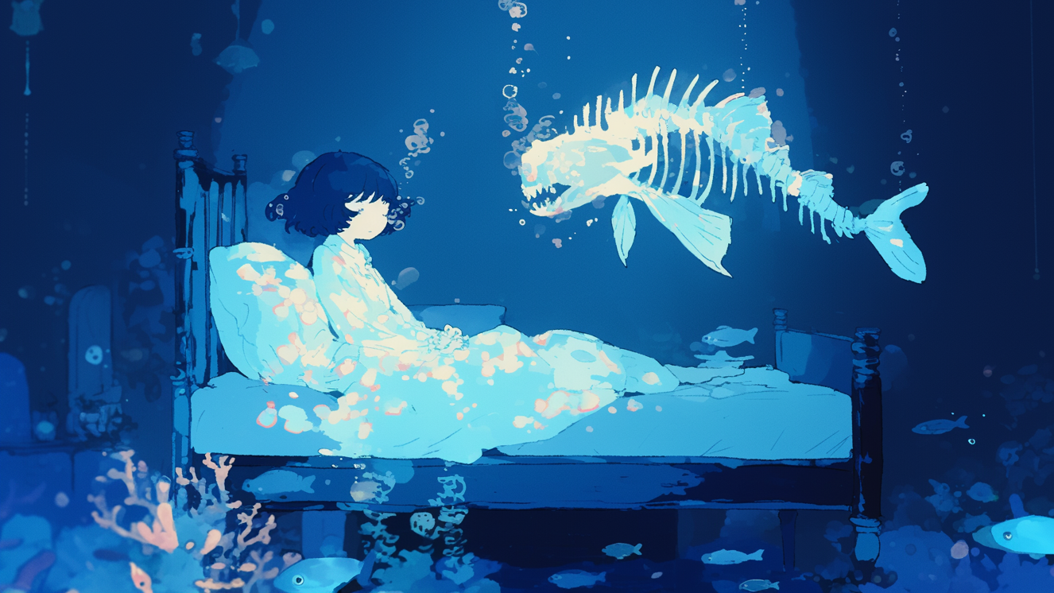
Healing Music
-水圧と体温-

Slide 3
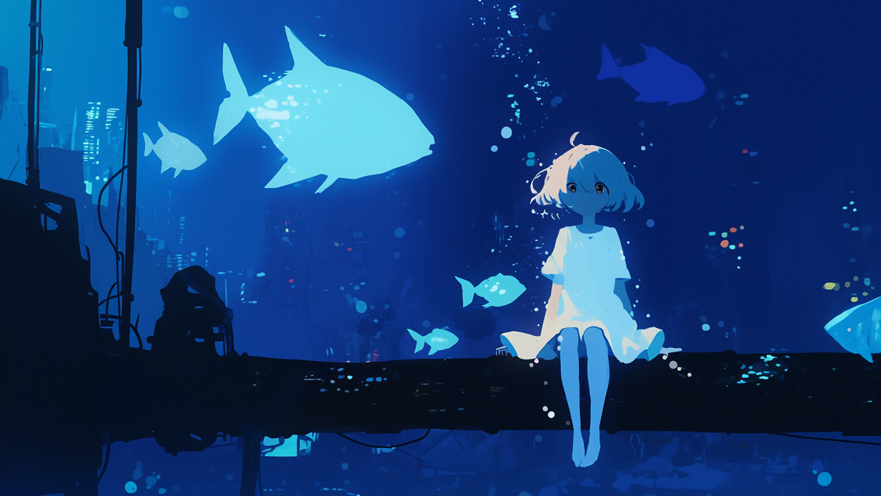
Healing Music
-水底に沈む街-

Slide 4
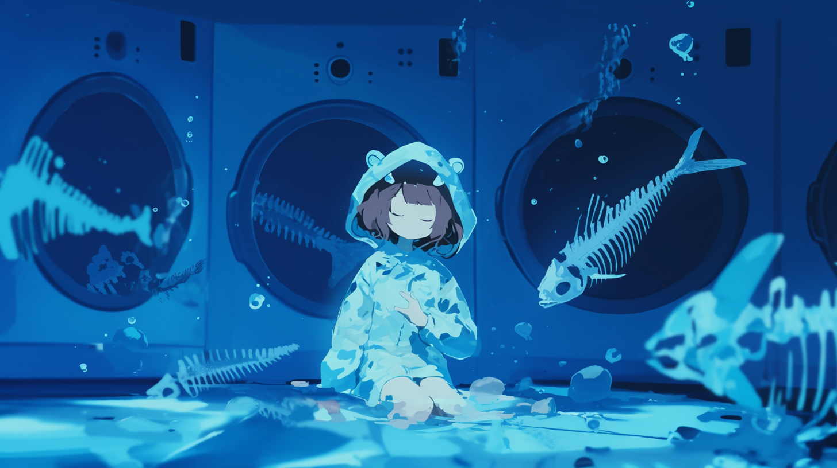
Healing Music
-深海魚も眠る時間-

Slide 5
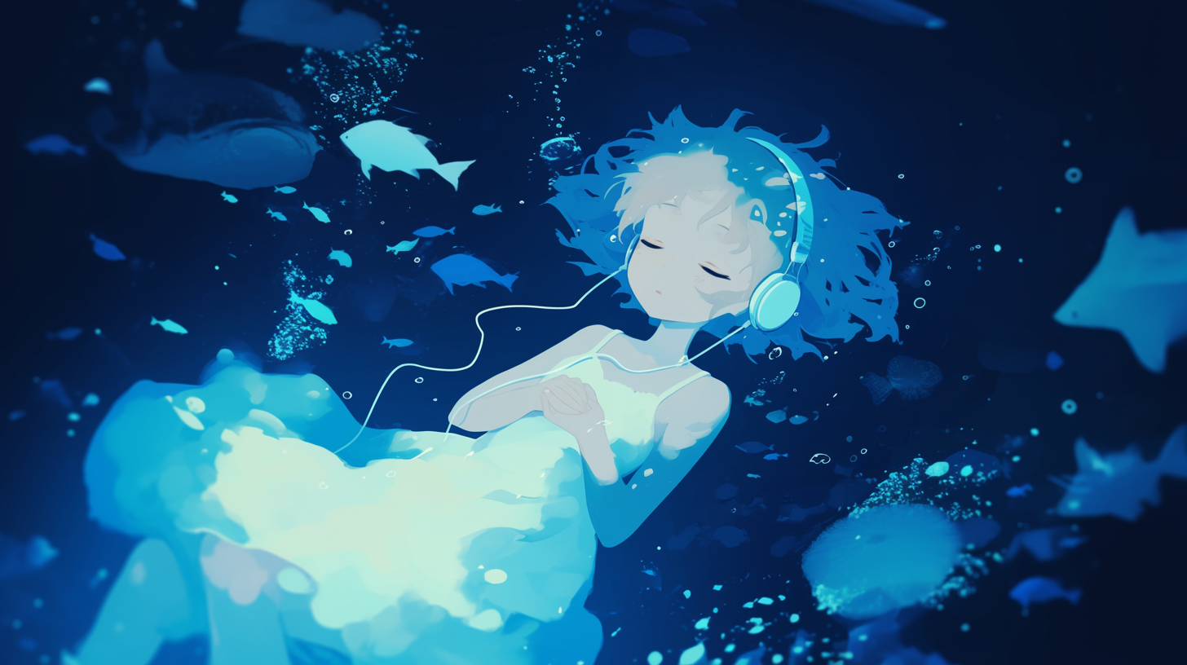
Healing Music
-水没する意識-

Slide 6
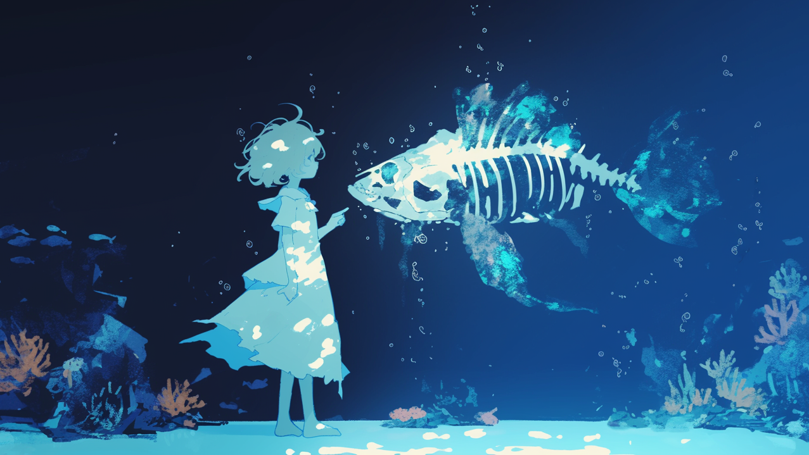
Healing Music
-海の記憶の断片-

Slide 7
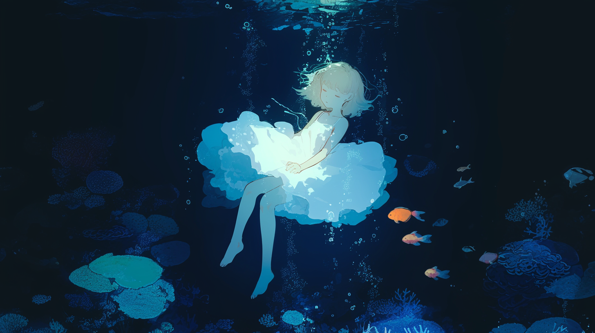
Healing Music
-月光の届かぬ水底-

Slide 8

Healing Music
-海中遊泳-

Slide 9
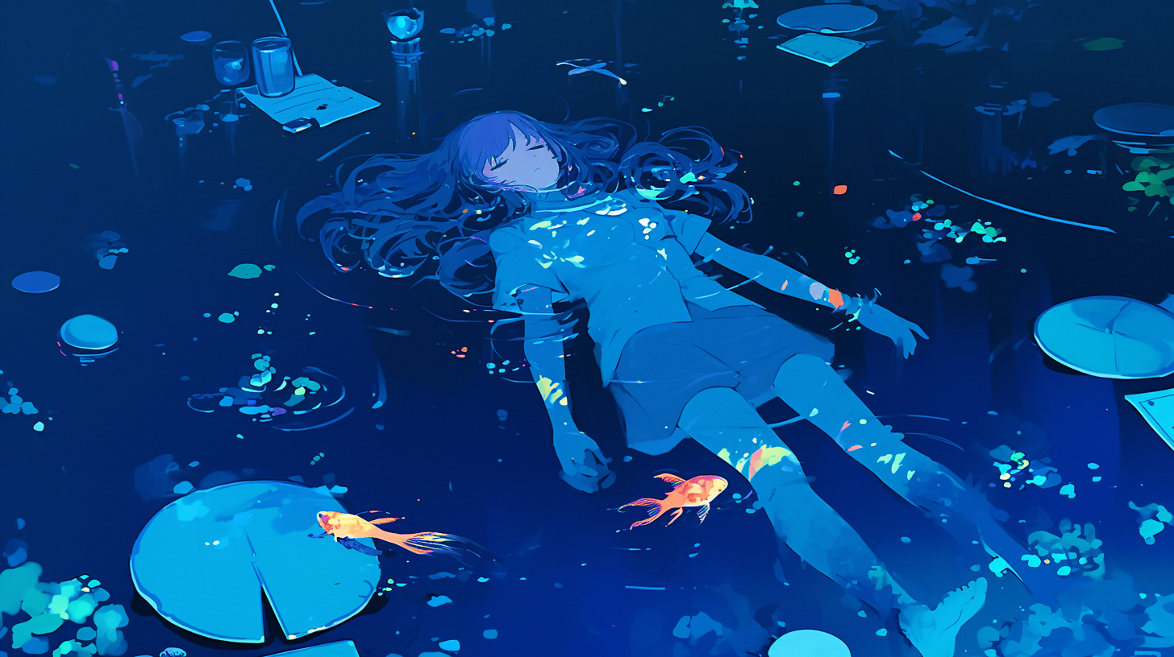
Healing Music
-藍色の子守唄-

Slide 10
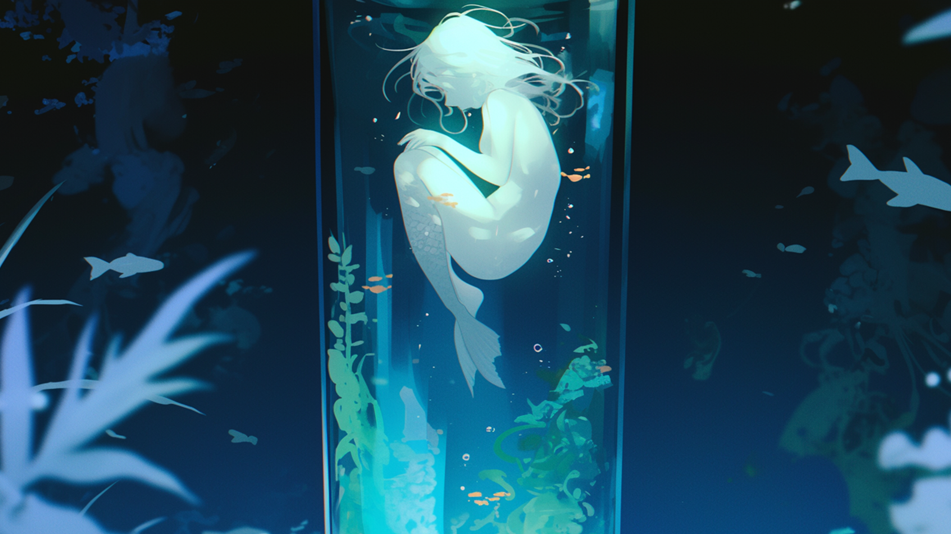
Healing Music
-水精の揺籠-

Slide 11
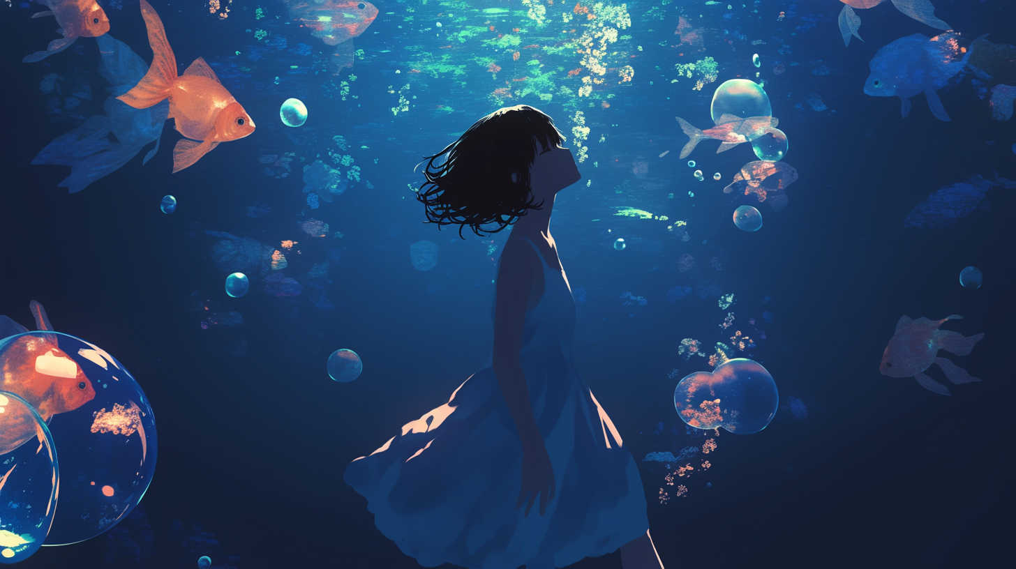
Healing Music
-泡沫の夢路-

